Slide 1
Bank Loan Case Study

Slide 2
Problem Statement
Present the overall approach of the analysis in a presentation. Mention the problem statement and the analysis approach briefly.
Identify the missing data and use appropriate method to deal with it.
the missing value, what should be the approach. Clearly mention the approach.
Identify if there are outliers in the dataset. Also, mention why do you think it is an outlier. Again, remember that for this exercise, it is not necessary to remove any data points.
Identify if there is data imbalance in the data. Find the ratio of data imbalance.
Notes:
s

Slide 3



Technology Used
I have used Microsoft Excel to do the analysis and Jupyter for cleaning the Application data as it is having large number of rows.
I used Microsoft presentation to make ppt for the project
Notes:
s

Slide 4

Clean Data
Data cleaning is a crucial step in any data analysis process as it ensures the data is accurate, reliable, and consistent. Without proper data cleaning, the analysis can become inaccurate, incomplete, and inconsistent, potentially leading to serious consequences in decision-making. Ensuring data quality is essential for making informed and effective decisions.
Notes:
s

Slide 5
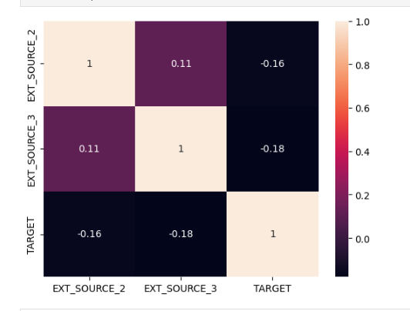
Data Analysis
EXT_SOURCE and target
Notes:
s

Slide 6
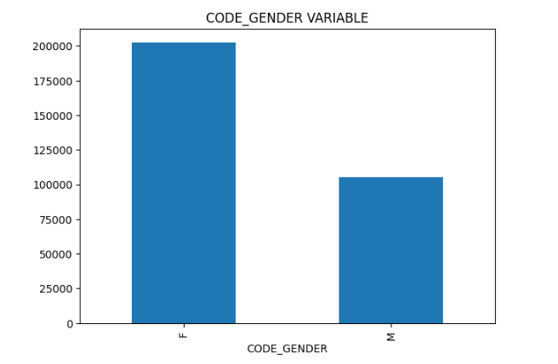
Data Analysis
Observation of male female and XNA, so we replace xna to female
Notes:
s

Slide 7
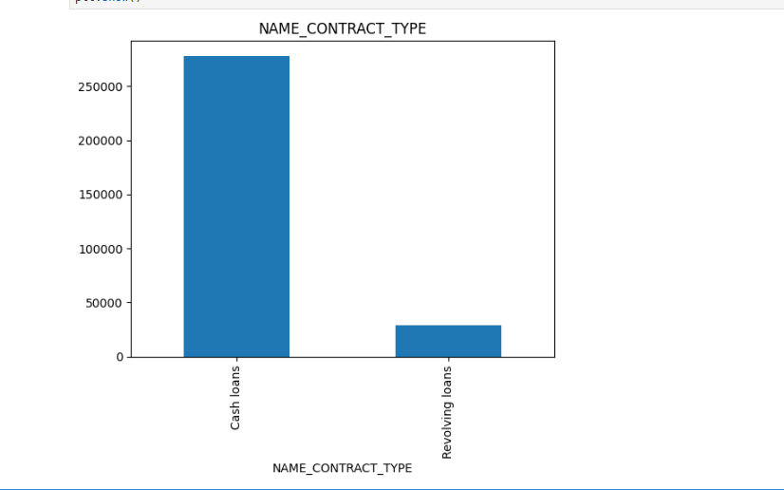
Data Analysis
Contract type cash loans and revolving loans
Notes:
s

Slide 8
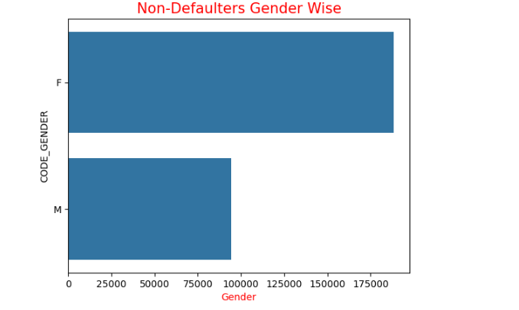
Data Analysis
Non defaulter Gender Wise
It's clearly visible now that the more no of females are paying their bills correctly compare to males.
Same goes for Defaulters as well. Females nos are more compare male here.
Notes:
s

Slide 9
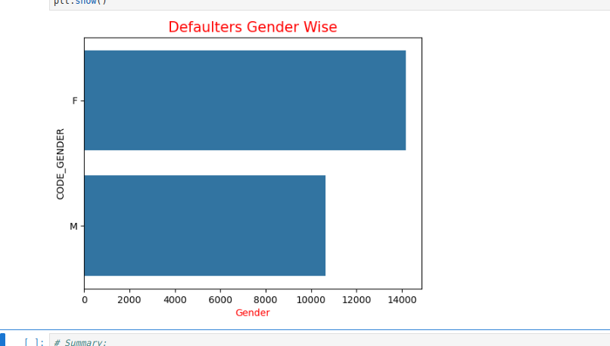
Data Analysis
Defaulter Gender Wise
Notes:
s

Slide 10
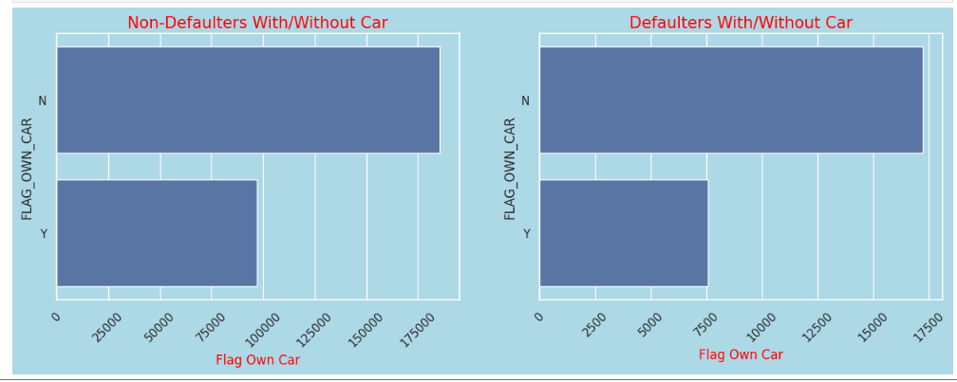
Data Analysis
Maximum no of Non-defaulters are not having their own car.
Maximum Defaulters also not having their own car.
Notes:
s

Slide 11
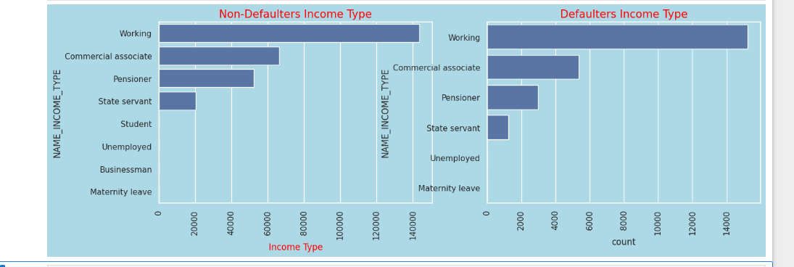
Data Analysis
The Defaulters are mostly working professionals following by commercial Associates.
Notes:
s

Slide 12
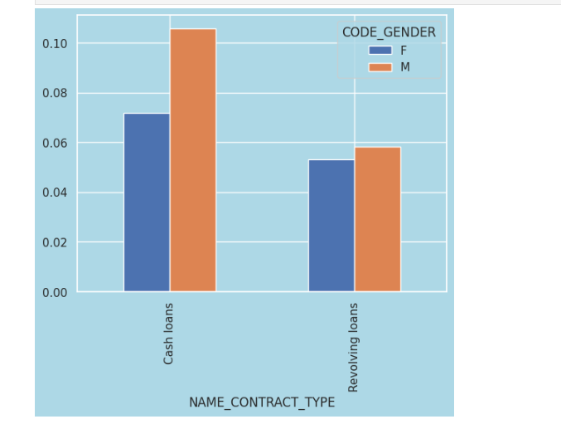
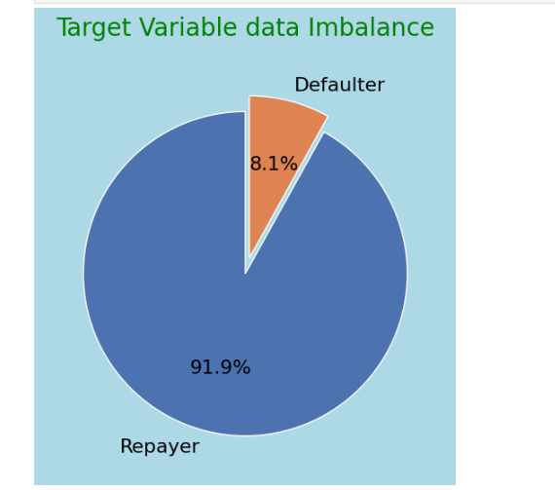
Data Analysis
Cash Loans and Revolving loans
Notes:
s

Slide 13
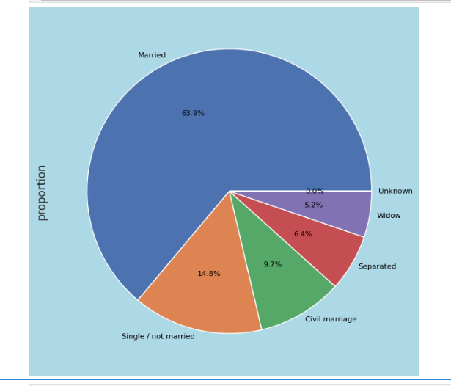
Data Analysis
Most of people take loan is married
Notes:
s

Slide 14
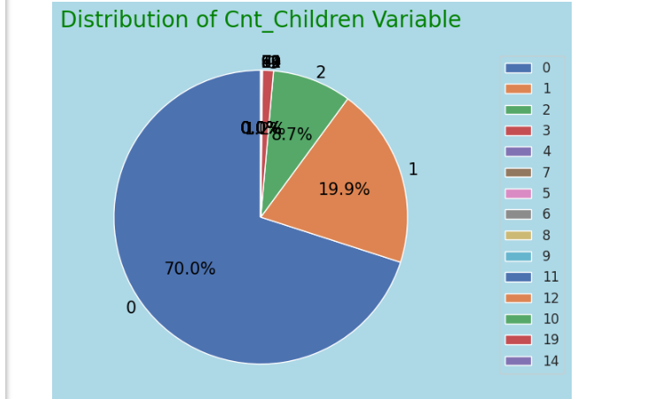
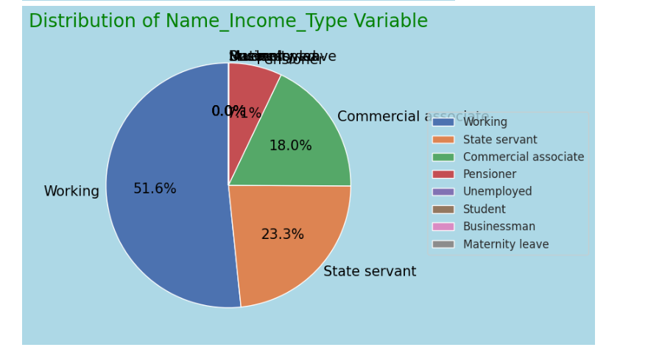
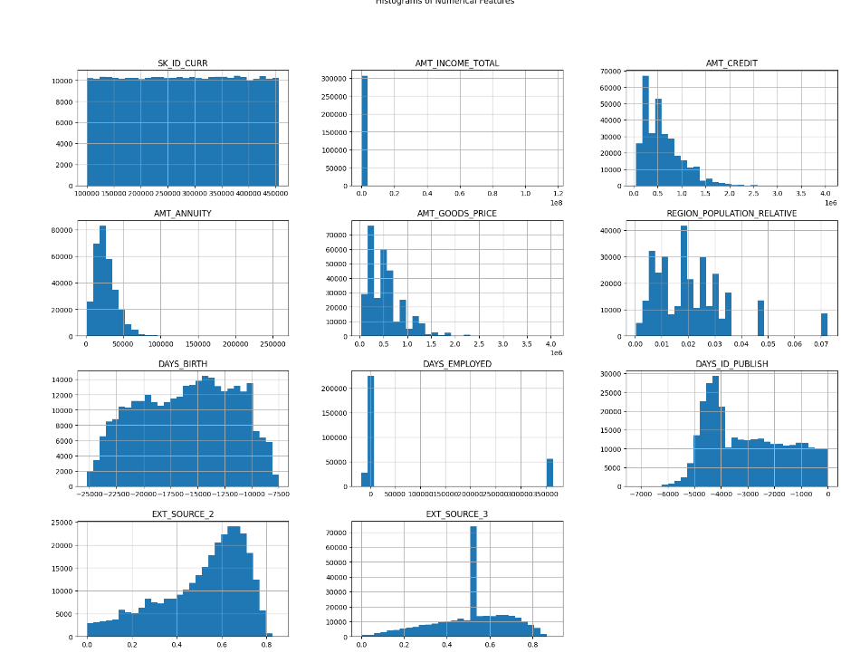
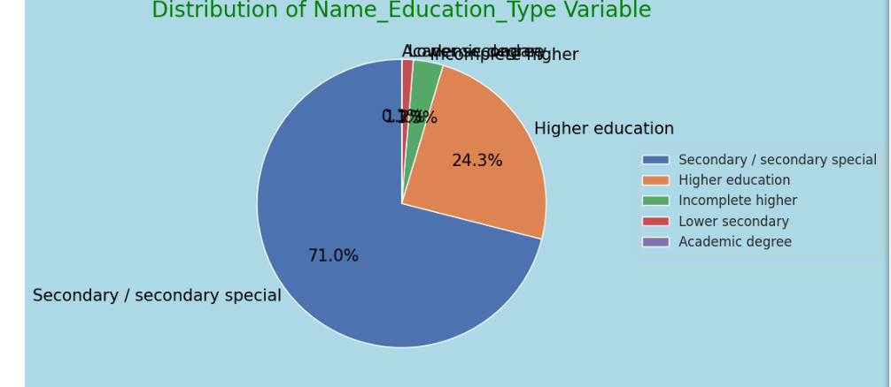
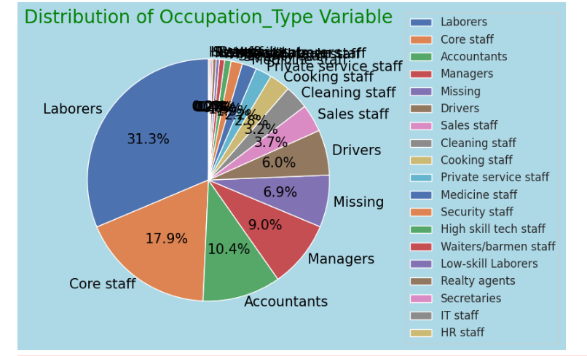
Data Analysis
Other different charts:
Notes:
s

Slide 15
Data Analysis
Other different charts:
Notes:
s

Slide 16
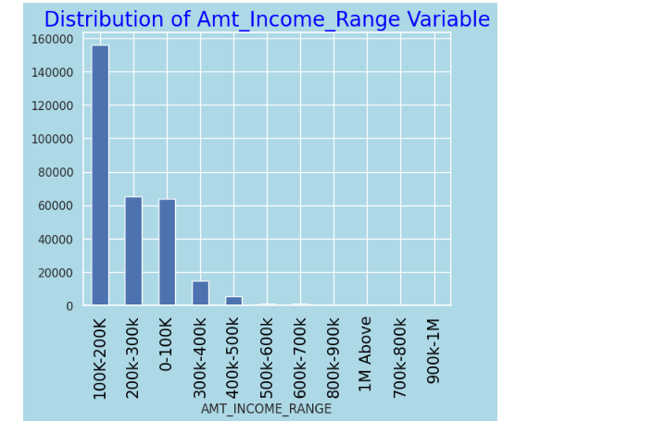
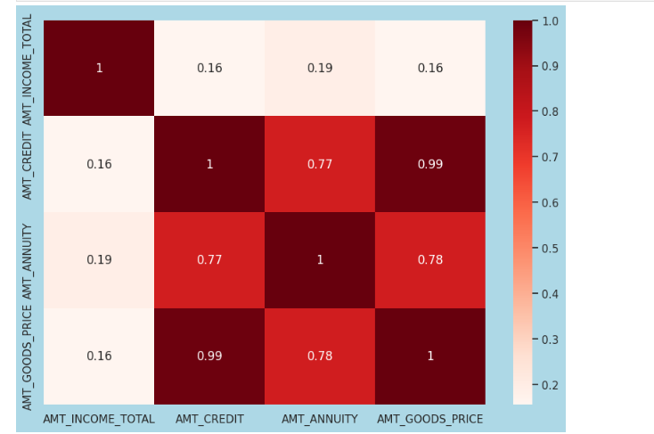
Data Analysis
Amt income range variable and heat map
Notes:
s

Slide 17
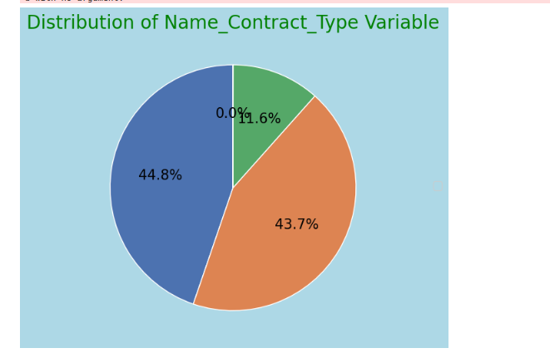
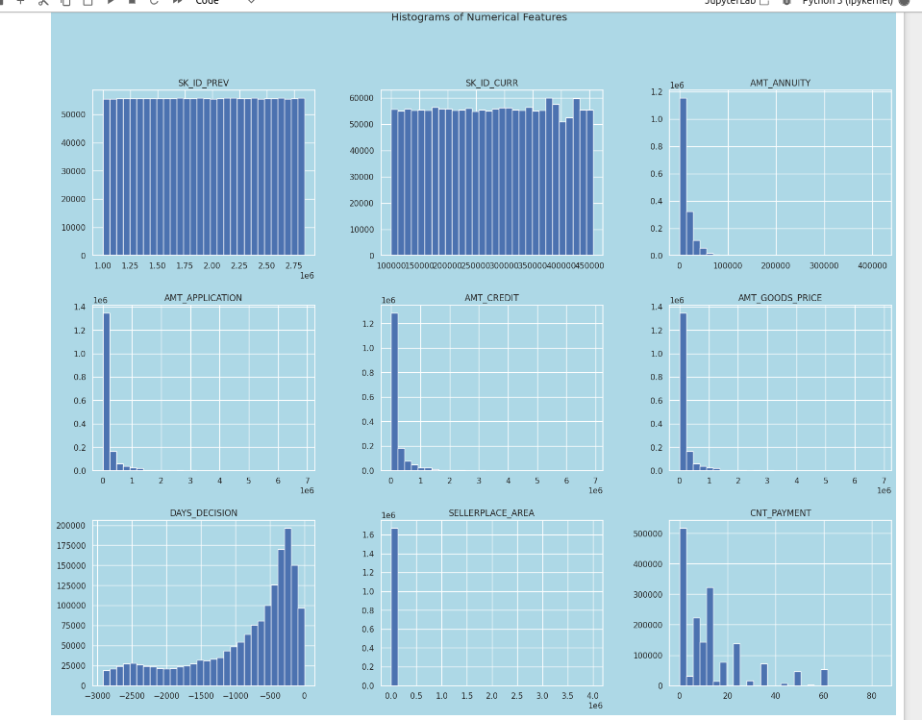
Data Analysis
Specific previous application data charta
Notes:
s

Slide 18
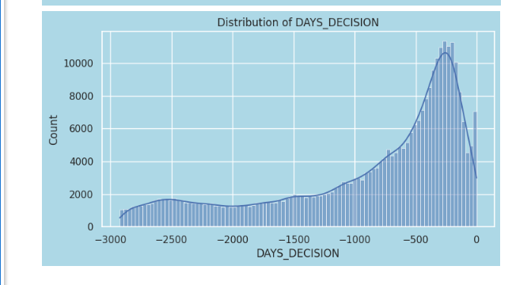
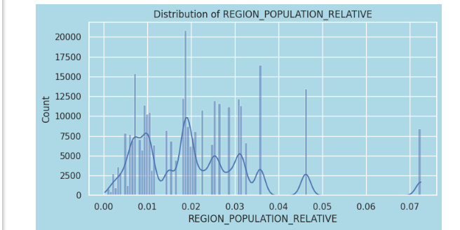
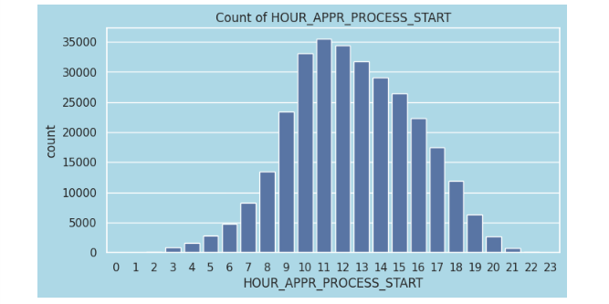
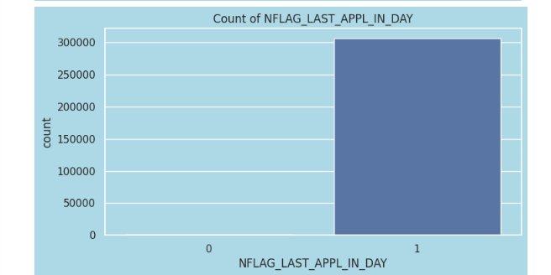
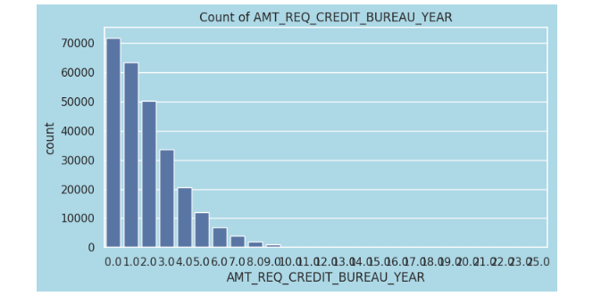
Data Analysis
After merge the previous day sheets and appdata sheets get the output
Notes:
s

Slide 19
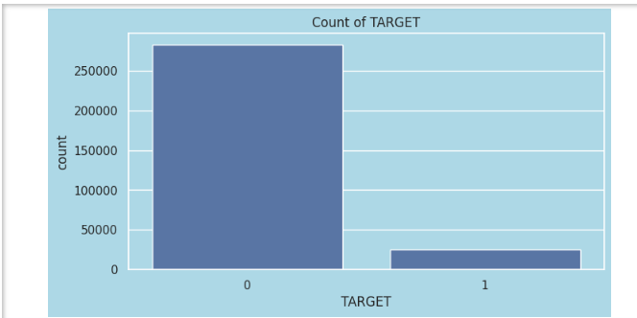
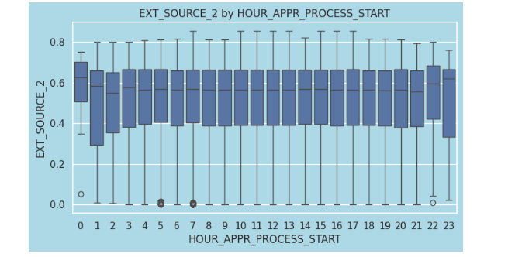
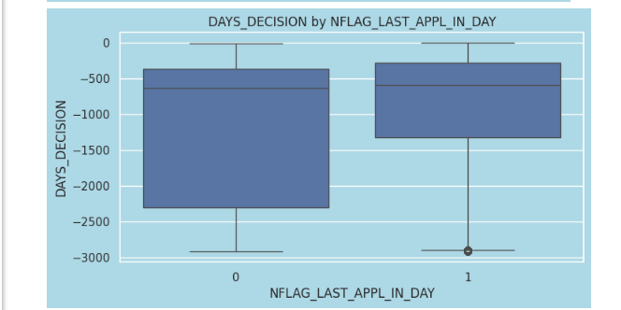
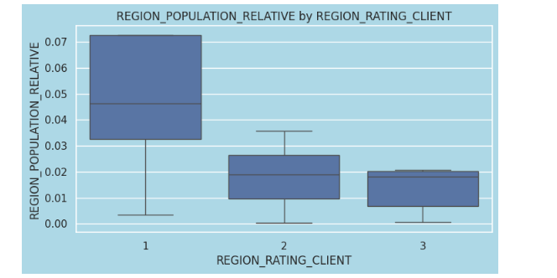
Data Analysis
After merge the previous day sheets and appdata sheets get the output
Notes:
s

Slide 20
Summary :
Highly Recommended:
Previous Application Approved Clients: These clients have a history of approved loans, indicating reliability and trustworthiness.
Married Clients: Marital status often correlates with financial stability and dual income potential.
Senior Clients: Older clients typically have more established financial histories and assets.
More Educated Clients: Higher education levels often lead to better job opportunities and higher incomes.
Customers with a High Income: These clients have the means to repay loans more comfortably.
Clients with a Greater External Source: Additional sources of income or financial support reduce the risk of default.
Females: Statistically, women have shown to be reliable in repaying loans.
Customers with Strong Work Experience: Extensive work experience indicates job stability and a steady income.
Notes:
s

Slide 21
Summary:
High-Risk Groups :
Clients that are Unemployed: Lack of employment makes loan repayment uncertain.
Youth Clients: Younger clients often have less financial history and stability.
Low-Income Clientele: Limited income can make it challenging to meet loan repayment obligations.
Clients with Insufficient External Sources: Lack of additional financial support increases the risk of default.
Customers with Little Work Experience: Inexperienced workers might have unstable incomes.
Customers on Maternity Leave: Temporary leave from work can impact income and repayment capacity.
Clients with a Larger Number of Family Members: More dependents can strain financial resources, making loan repayment more difficult.
Notes:
s

Slide 22
Thank You
Nayan Bharada
Notes:
s

